Slide 1
Last day of class!

Slide 2
Announcements
Final project due tomorrow!
Please complete the SPOT scores
Bad ggplots today

Slide 3
Why do we do this?
Failure is central to academia and laughing and acknowledging our failures along the way helps us grow (and detoxifies success culture)

Slide 4

Ways to grow from (or at least not be devastated by) failure
Be honest
Be thankful
Take Responsibility
Learn from it
Move on
From: McCardle ‘The Up Side of Down: Why Failing Well is the Key to Success’

Slide 5
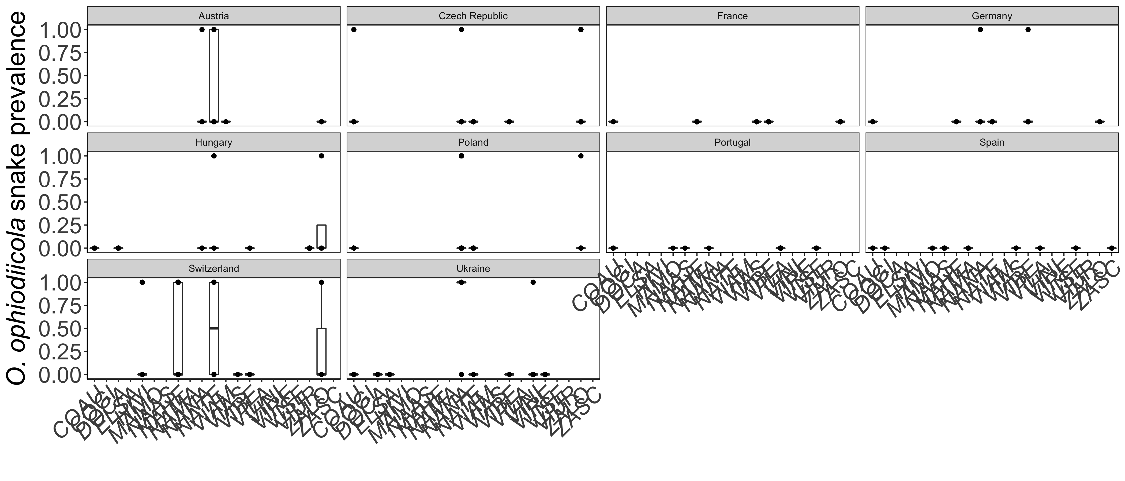
#1

Slide 6
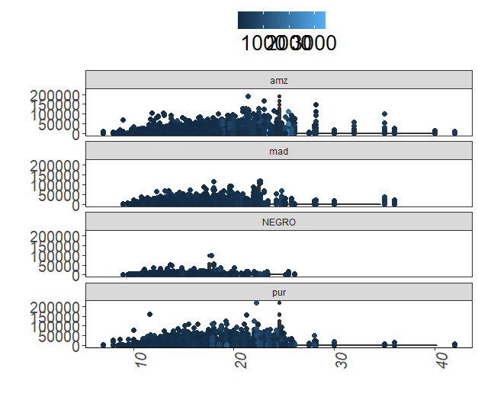
#2

Slide 7
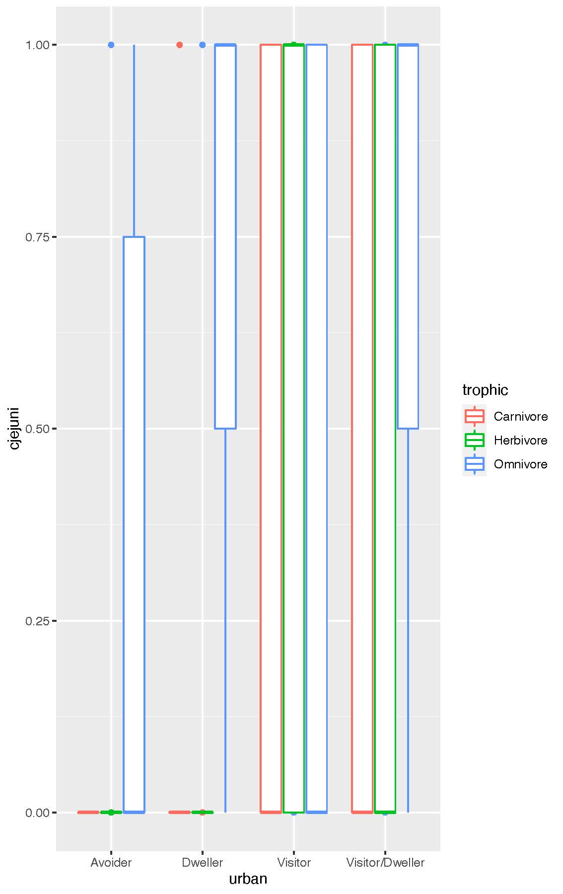
#3

Slide 8
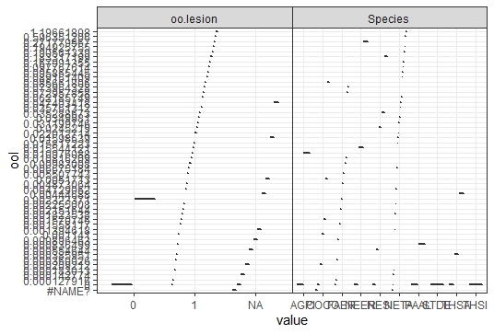
#4

Slide 9
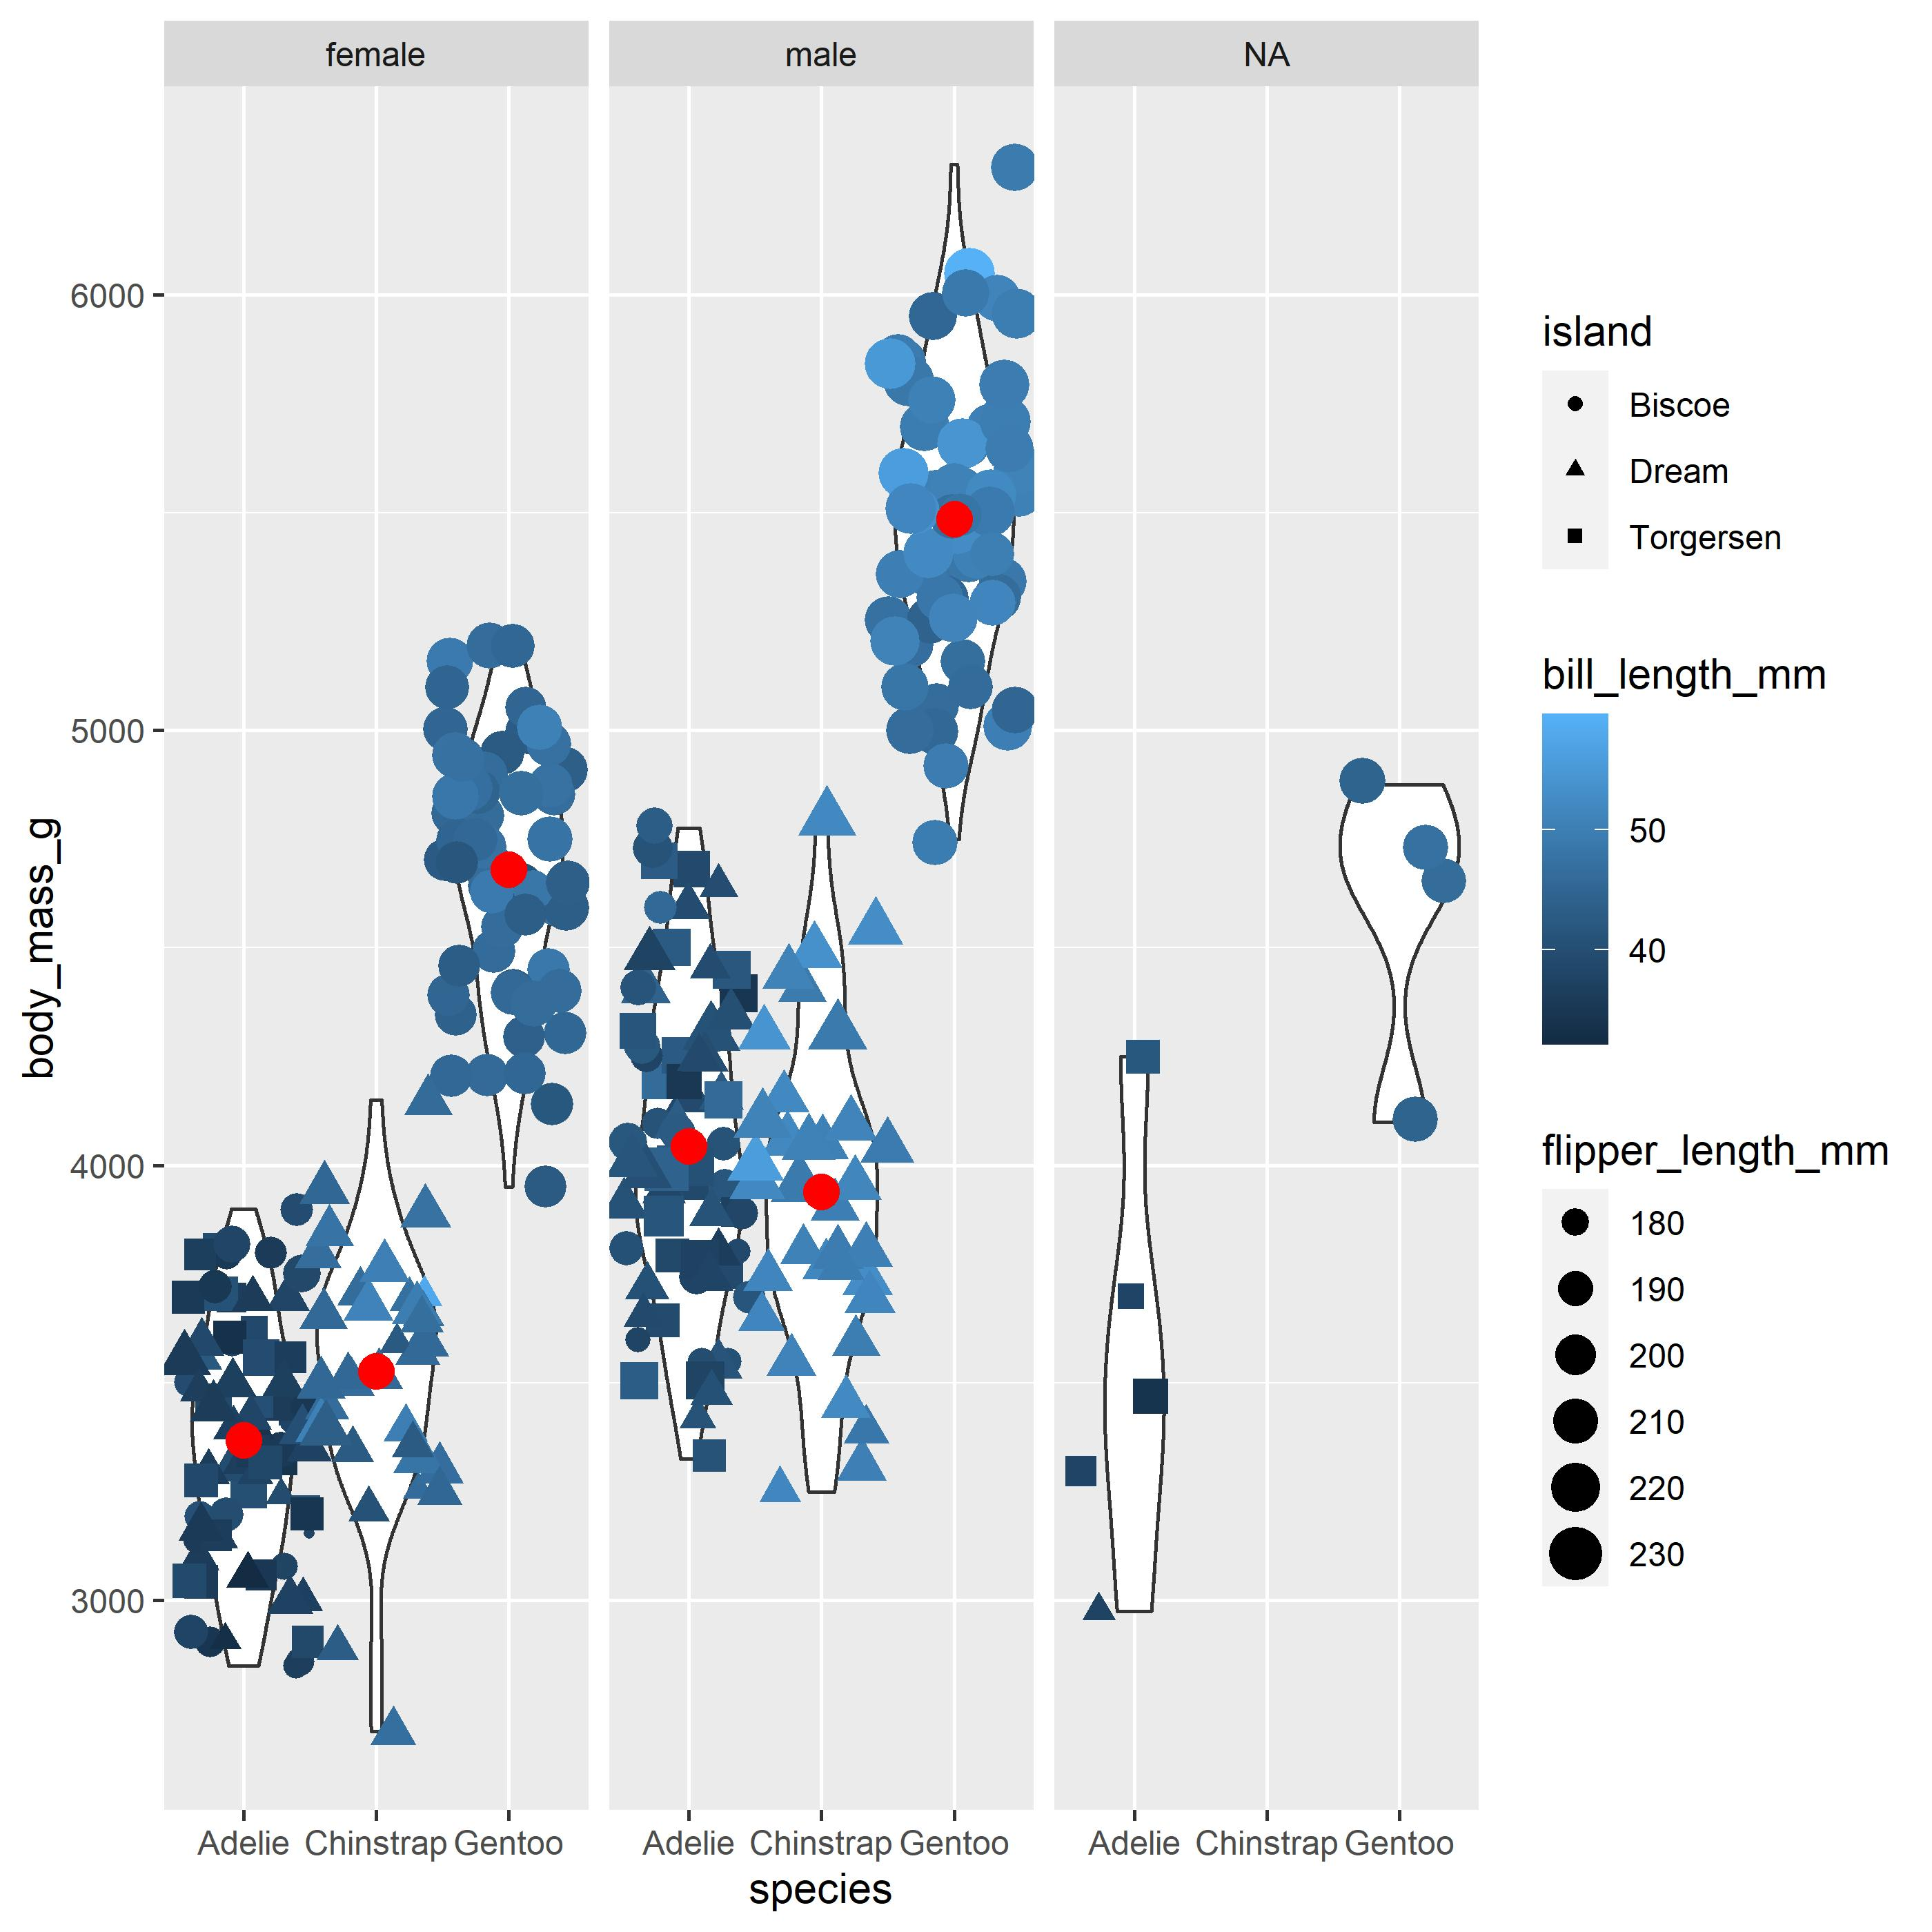
#5

Slide 10
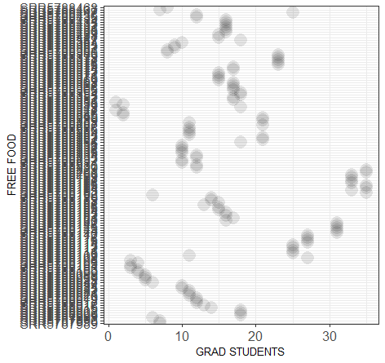
#6

Slide 11
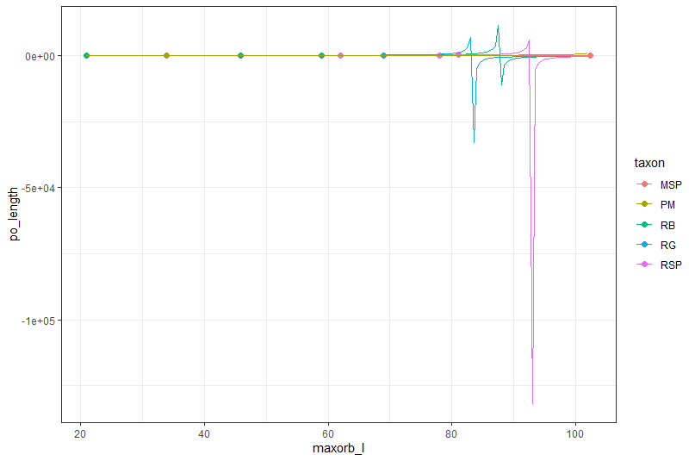
#7

Slide 12
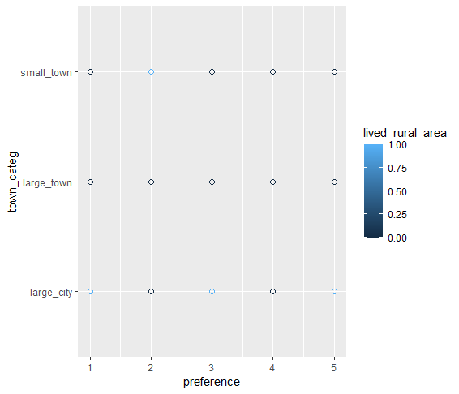
#8

Slide 13
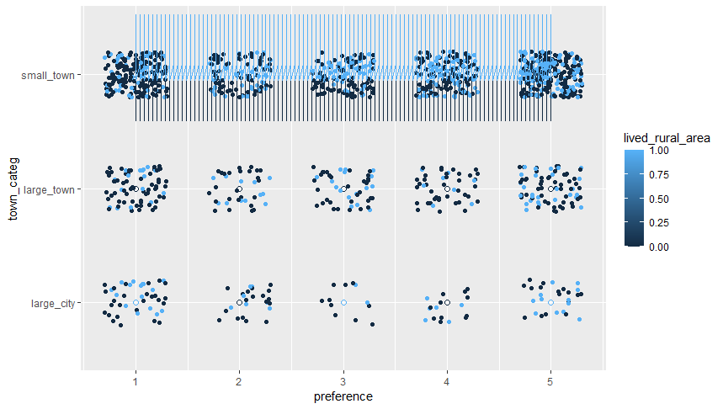
#9

Slide 14
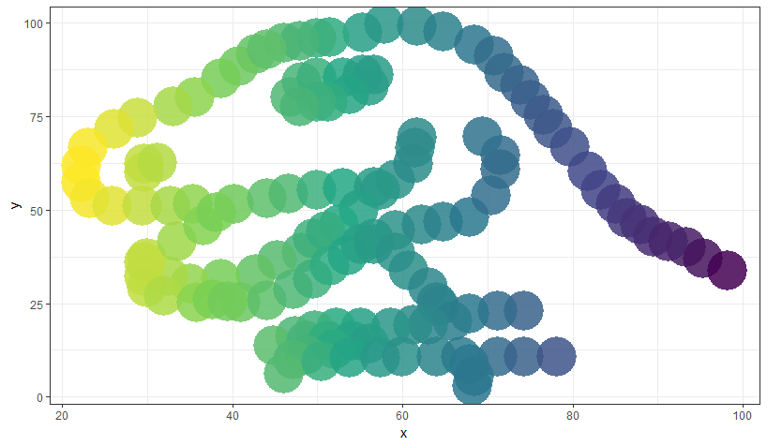
#10

Slide 15
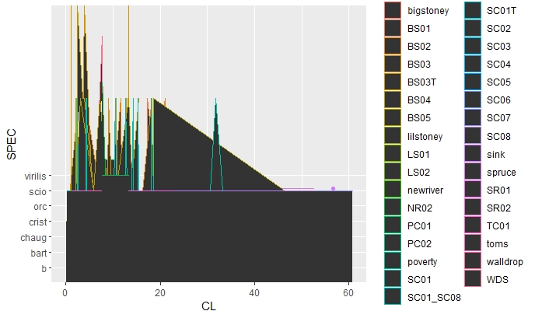
#11

Slide 16
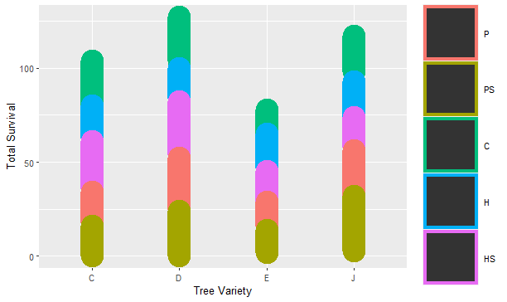
#12

Slide 17
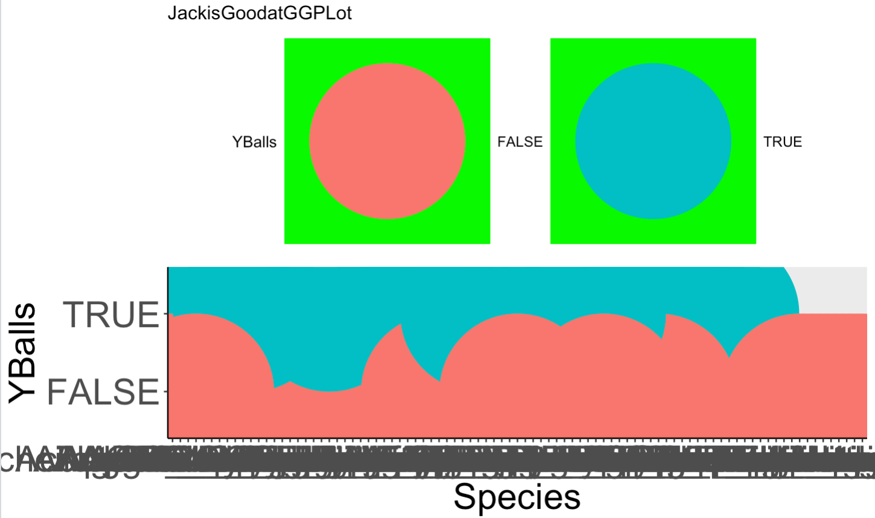
#13

Slide 18
#14

Slide 19
Vote at: PollEv.com/katelangwig411

